Slide 1
UK Minimum Wages and the Low Pay Commission
Stephen Machin

Slide 2
The UK National Minimum Wage
First | introduced | in | April 1999 at | £3-60 for
over | 21s, £3-00 | for | 18-21s, none | for 16-17
year olds (to start with). Subsequently was uprated
(by fairly small
amounts at first, bigger ones later and then by less in the downturn). Now (after last change was made in October 2014) stands at £6.50 for the adult rate, at £5.13 for the development rate and, since October 2004, there is a rate for 16-17 year olds (currently £3.79). There is also now a rate for apprentices (of £2.73) which was introduced in 2010.

Slide 3
Debate About a Wage Floor in the 1990s Prior to Introduction
Pro
Trade Unions
Lobby Groups
  Low Pay Unit
Labour Party
Press
  Daily Mirror
Against
Business Groups
Conservative Party
City Economists
Press
  The Economist

Slide 4
Low Pay Commission
9 Commissioners, of whom:
Chair
2 academic labour economists
3 trade union background
3 employer background
Makes recommendations to government each year and writes report.
Supported by a small Secretariat (fewer than 10 Civil Servants – policy, analysis, admin).

Slide 5
Low Pay Commission
Evidence based judgement – NOT a formula.
Involves:
Assessment of impact to date; Academic research;
State and prospects for the economy and for earnings in particular;
Stakeholder views;
Assessment of other government legislation.

Slide 6
Low Pay Commission
Evidence gathering:
In house and commissioned research; Academic research;
Formal consultation process; Visits around the UK;
Secretariat meetings with stakeholders; International developments.

Slide 7
Low Pay Commission
Particular focus on specific areas:
Low paying industries/occupations – retail; hospitality; social care; cleaning; security; agriculture; textiles and clothing; leisure, travel and sport; food processing; child care.
Small firms.
Low paid | workers | – women; part-timers; | migrants;
disabled; | young | people; apprentices; | interns;
homeworkers; agency workers.

Slide 8
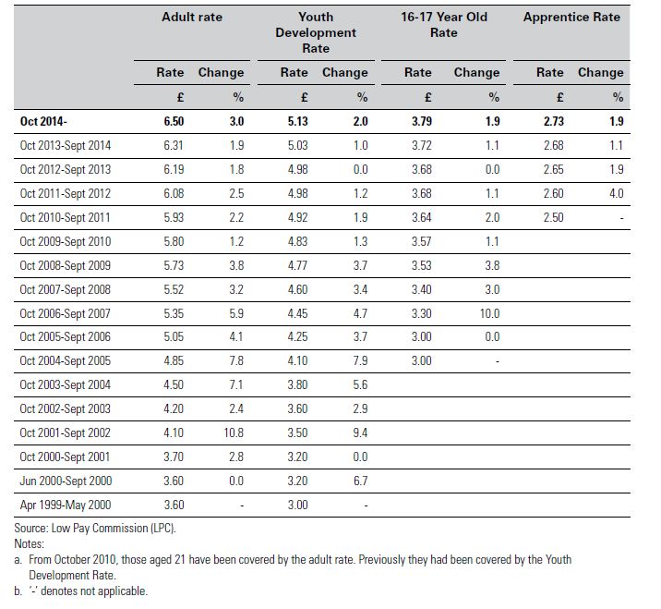
UK Minimum Wages, 1999 to 2014

Slide 9
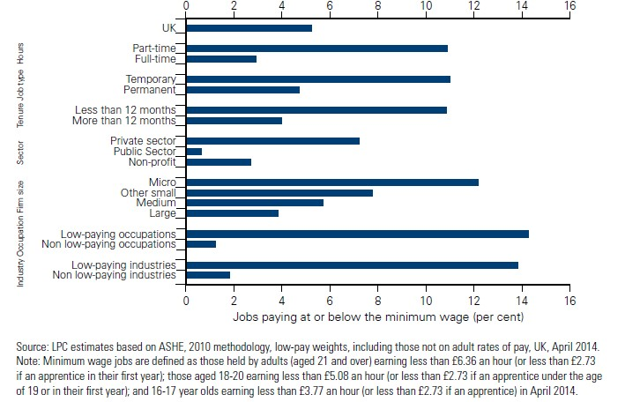
UK Minimum Wage Jobs, 2014

Slide 10
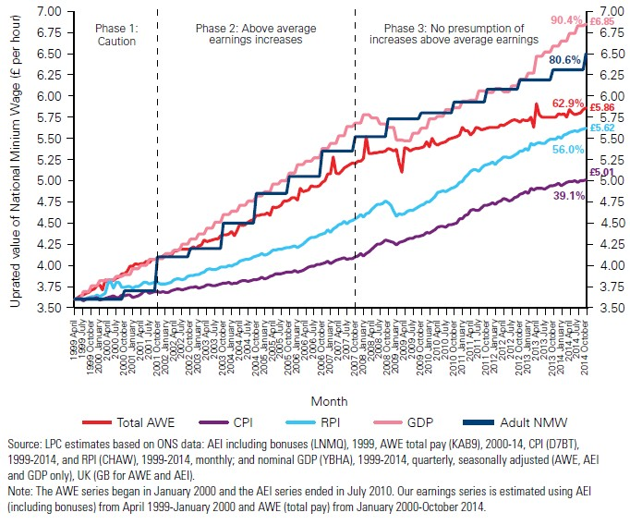
UK Minimum Wage Growth

Slide 11
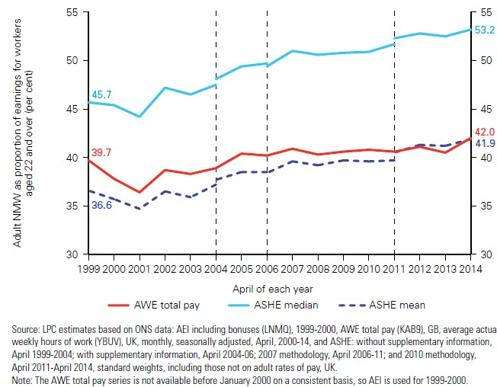
UK Bite of Minimum Wage

Slide 12
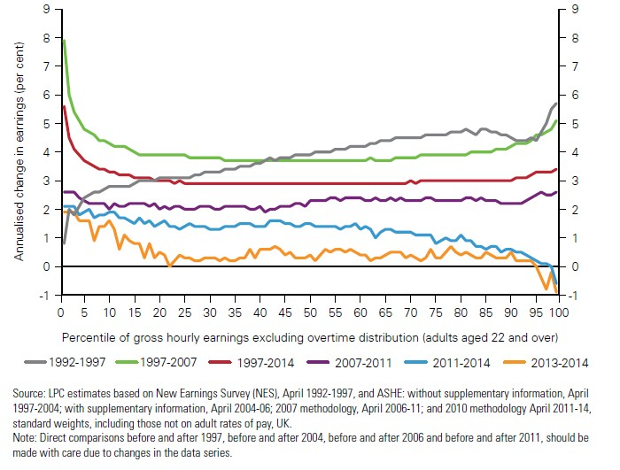
Hourly Earnings Growth by Percentile, 1992 to 2014

Slide 13
UK National Minimum Wage and Wages
As previous charts have shown, low wage workers received significant wage boost.
Also shown in academic research that defines a
‘treatment’ Swaffield).
[treatment:
and ‘control’ group (Stewart,
below NMW in t-1; control just
above NMW]
And in work looking at spatial differences (Stewart).
→ necessary ‘first stage’ for evaluating impact.

Slide 14
UK National Minimum Wage and Employmen
Key economic question concerns impact on employment.
LPC stated that their view was that NMW was set at level that would not harm jobs (logic is idea that can have monopsony power up to a certain level of wages so get inverse U-shape in employment effects).
In academic research, can be looked at as ‘second stage’ after establishing wage impact.

Slide 15
UK National Minimum Wage and Employmen
Two sets of studies: 1). Introduction Stewart – second
stage of treatment/control
microdata setting; Stewart – spatial estimation; Machin, Manning, Rahman – care homes.
2). Upratings
Dickens, Riley, Wilkinson; Various LPC reports – treatment/control microdata setting.
→ Evidence suggests no disemployment effects.

Slide 16
Assessment of UK Minimum Wage Setting
“…coming up with a minimum wage that will not seriously harm the economy, and destroy jobs, will require the wisdom of Solomon – or extraordinary luck.”
The Economist (5 June 1997)

Slide 17
Assessment of UK Minimum Wage Setting
Overall has been perceived to be a success.
Government has always recommendations on the main rates.
accepted
Institute | of Government | reported | that | the
"minimum | wage tops the | chart of | the | most
successful policies of the last 30 years".

Slide 18
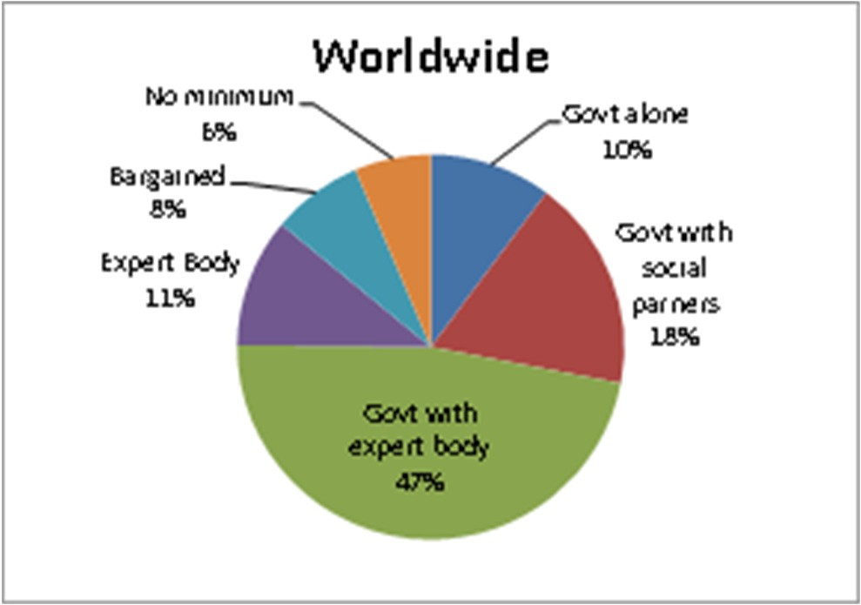
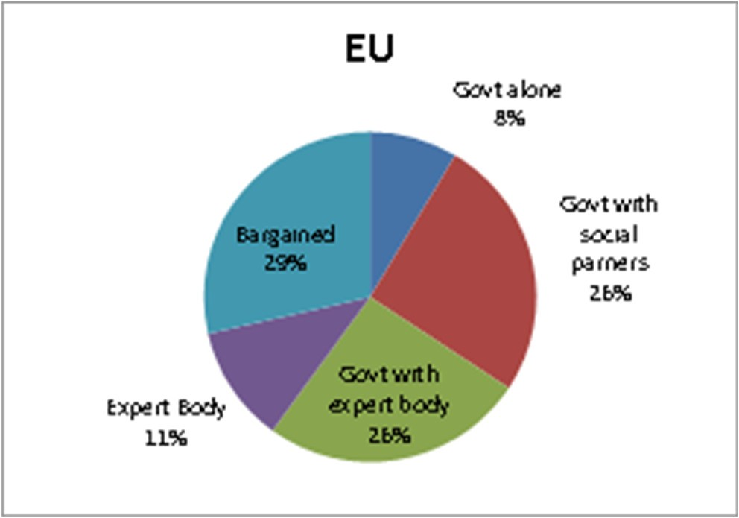
What Happens in Other Countries

Slide 19
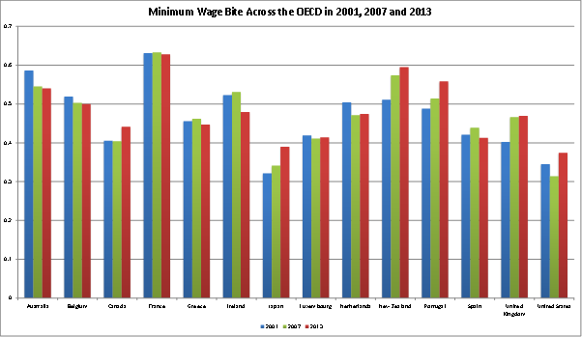
Minimum Wage Bite Across OECD

Slide 20
Conclusions
The minimum wage has never been so high up the political agenda, with politicians across the US, UK, Germany and other OECD countries calling for substantial increases.
This is in part because a consensus has emerged that minimum wages, set at the right level using a pragmatic approach, do not harm employment prospects.
Experience of UK minimum wage introduction is of high relevance to these current debates.

